Slide 1

Bank Marketing: Case Study
By – Onkar Suhas Samant

Slide 2




Brief Overview
Dataset Information
Inferential Analysis
Predictive Modeling
Outputs

Slide 3
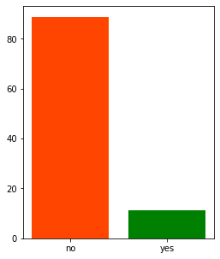
Dataset Information
The Portuguese Bank Marking data is provided by UCI
There are 20 features/variables and 1 class i.e. term-deposit (yes-subscribed, no–not subscribed) and 411K records
The features contain client data, campaign data and social/economic context attributes. Features are a mix of continuous and categorical data type.
The data contains individuals above 17 years of age and most of the people in the population have a university degree education, are married and have not defaulted before.
Term-deposit class is imbalanced, around 89% of the observations have term-deposit class as “no”
Term-Deposit Class (%)
Legend: term-deposit no, term-deposit yes

Slide 4
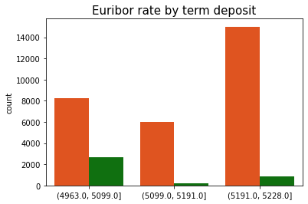
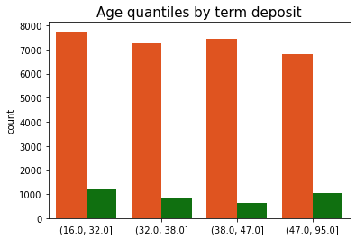
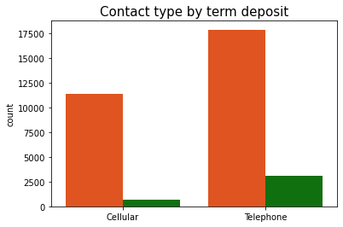
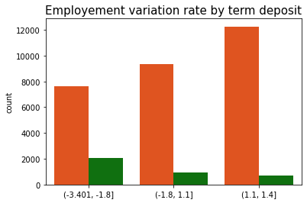
Inferential Analysis
Factors determining term deposit subscription: Euribor, Age, Contact-type, Employment Variation
Term-deposit class has a higher proportion when Euribor rate is low
Higher age groups have a slightly higher proportion of term-deposit yes class
The marketing calls on telephones have a higher proportion of conversion into a term-deposit subscription than calls on cellular
Lower employee variation has higher chance of term-deposit yes class
Legend: term-deposit no, term-deposit yes

Slide 5
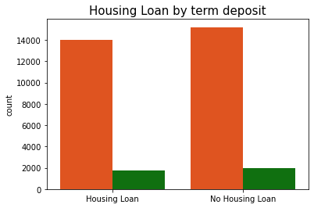
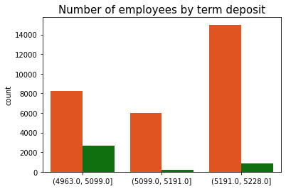
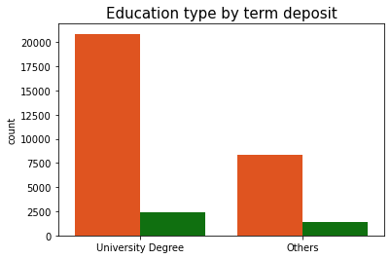
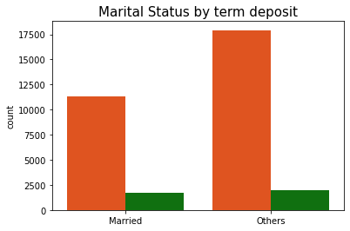
Inferential Analysis (Cont.)
Other important factors
Housing loan: Not much difference visually between people with housing loans and not with housing loans in terms of proportions of term deposit class
Number of Employees: Proportion of people with subscription of term-deposit is higher for lesser number of employees in the bank
Education type: Not much difference visually between proportions of the two classes based on education type
Marital Status: Slightly higher proportion of term-deposit subscription clients amongst married people
Legend: term-deposit no, term-deposit yes

Slide 6
Predictive Modeling
Motivation – Predicting clients subscribing to term-deposit would be very important for the bank’s marketing team in order to focus efforts on the right clients
Approach –
Important Features are selected using a wrapper-based feature importance technique
Metrics: Since the data is imbalanced and it’s much more important for the bank to identify the potential client who would subscribe, we focus metrics of term-deposit yes class. The metrics used are Average- Precision (Avg-Precision) and F1-Score
Classification models are trained on the training data (80% data). Following are the models tried:
Decision Tree
Logistic Regression
Random Forest
AdaBoost
K-Nearest Neighbors
XGBoost
All the algorithms are fine-tuned on their respective hyperparameters to give good Avg-Precision
Tuned models are tested on the unseen data (20% data) and the results are tabulated

Slide 7
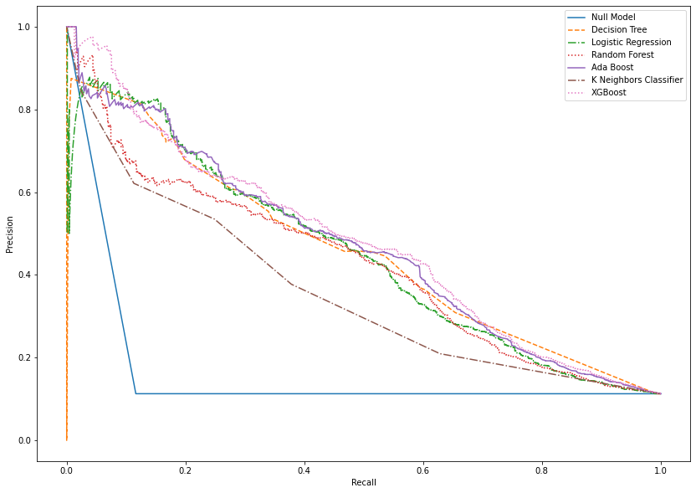
Results
XGBoost gives the best overall metrics
Precision vs Recall curve shows a tradeoff between two metrics for varying threshold
All the models perform better than the Null Model i.e. model without any features
Precision vs Recall
Results on the test-set
Model | Avg-Precision | F1-Score
Null | 0.11 | 0.20
Decision Tree | 0.41 | 0.49
Logistic Regression | 0.45 | 0.47
Random Forest | 0.43 | 0.47
AdaBoost | 0.47 | 0.50
K-NN | 0.29 | 0.38
XGBoost | 0.48 | 0.51
Note: Models can be fine tuned more for better metrics

Slide 8
Future Scope
Other Models: More complex models like Support Vector Machines and Neural Networks can be tried
Different metric: Asymmetric misclassification rate can be used with more weightage for false positives and false negatives based on domain knowledge. False negatives are costlier for the bank as it cannot afford to miss out on a potential client who might subscribe for a term deposit
Better Feature Engineering: There is a scope for more feature engineering based on the current attributes to get better prediction results

